Slide 1
SENTIMENT ANALYSIS
Gizem BAŞARAN
20SOFT1041

Slide 2
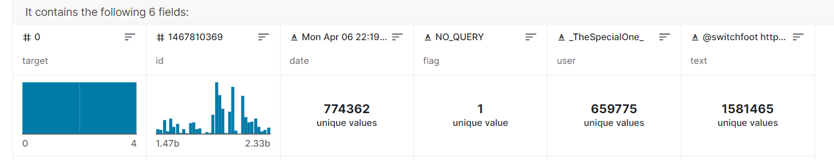
DATASET INFORMATION
This is the dataset i chose from Kaggle. It contains 1,600,000 tweets extracted using the twitter api.
The tweets have been annotated (0 = negative, 4 = positive) and they can be used to detect sentiment.

Slide 3
USED PYTHON LIBRARIES
numpy
pandas
re
pickle
sklearn

Slide 4
NumPy: is used to process numerical data arrays. It offers capabilities for vector and matrix arithmetic, as well as tools for modifying and manipulating arrays, like reshaping, slicing, and sorting, to conduct mathematical operations on large arrays of data.
Pandas:
For storing and modifying data in a tabular manner, use DataFrame and Series data structures.
Tools for reading and writing data in CSV, Excel, JSON, and SQL file formats, among others.
Operations for handling missing data and handling it
Merging and combining several datasets

Slide 5
Pickle: This library provide piece of code is saving the classifier object in a binary file, so that it can be loaded and used again later without having to retrain the model.
Sklearn: It provides a selection of efficient tools for machine learning and statistical modeling including classification, regression, clustering and dimensionality reduction via a consistence interface in Python.
Generates a report that shows the precision, recall, f1-score, and support for each class of a classification problem, based on true and predicted labels.
Both train_test_split and classification_report are commonly used during the model evaluation process.

Slide 6
PREPROCCESING
Lower casing
Tokenization
Lemmatization
Convert all urls to sting «URL»
Convert all @username to «USERNAME»
Correct all multiple white spaces to a single white space
Convert "#topic" to just «topic«
Stop words removal
Remove punctuations

Slide 7
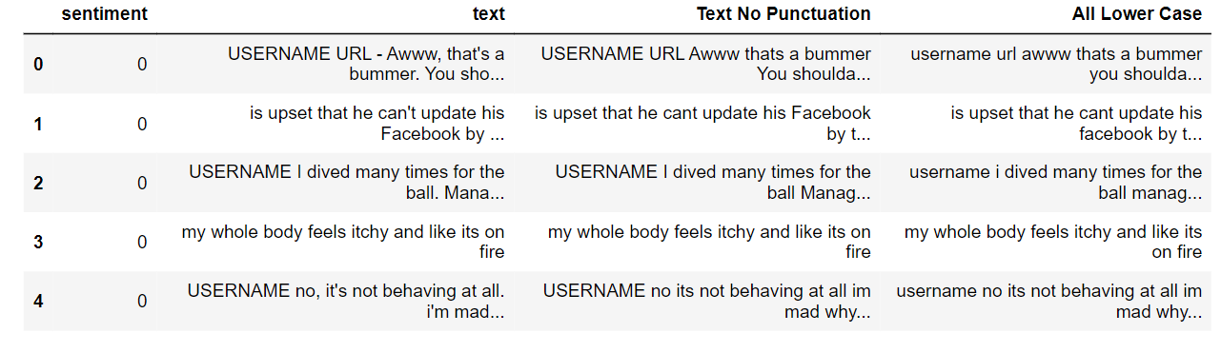

Slide 8
FEATURES EXTRACTION
TfidfVectorizer is a feature extraction method used to convert a collection of raw documents to a matrix of TF-IDF features. This class is equivalent to CountVectorizer followed by TfidfTransformer. TF-IDF stands for Term Frequency-Inverse Document Frequency, is a statistical measure used to evaluate how important a word is to a document in a collection of documents. It is often used as a weighting factor in text retrieval and text mining. The importance increases proportionally to the number of times a word appears in the document but is offset by the frequency of the word in the corpus.

Slide 9
NAIVE BAYES
P(A|B) = P(A) * P(B|A)/P(B)
Where we are calculating the probability of class A when predictor B is already provided.
P(B) = prior probability of B
P(A) = prior probability of class A
P(B|A) = occurrence of predictor B given class A probability
MultinomialNB is a class for performing multinomial naive Bayes classification. Multinomial naive Bayes is a variant of the naive Bayes algorithm that is particularly suited for text classification problems with discrete features, such as word counts or term frequencies.
By importing this class for creating an instance of the MultinomialNB classifier and can be used it to train, predict and evaluate classification performance on my dataset.

Slide 10
ADVANTAGES
Easy to implement as you only have to calculate probability.
Use this algorithm on both continuous and discrete data.
Simple and can be used for predicting real-time applications.
Highly scalable and can easily handle large datasets.

Slide 11
DISADVANTAGES
This algorithm may have a lesser prediction accuracy than the other probability algorithms.
Regression is not possible with this.
The Naive Bayes technique can only be used to classify textual input; it cannot be used to forecast numerical values.

Slide 12
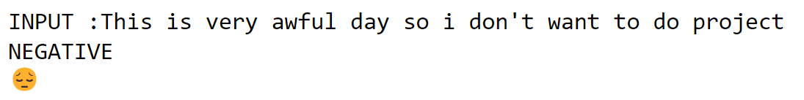
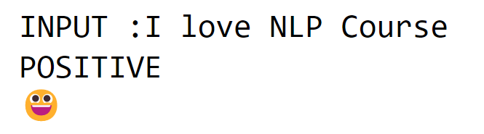
PREDICTION WITH 79% ACCURACY

Slide 13
CONCLUSION
Thanks to this project, I learned and applied the methods of pre-processing, feature selection and data accuracy analysis necessary to train and test a dataset and teach the model to the model and used classifier, with Python libraries and Weka.

Slide 14
THANKS FOR LISTENING

